Slide 1
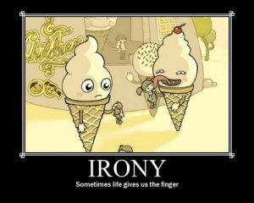
Irony
Definition: the use of words to convey a meaning that is the opposite of its literal meaning
My meaning: Irony is when everything is leading you to believe one thing is going to happen and then the complete reverse of that actually happens.
Example One: When Mrs. Mallard dies of a heart attack because her husband is alive instead of dying because he was dead.
(“A Story of an Hour”)
Example Two: When nobody wants to come to Gatsby’s funeral, even though everyone wanted to come to his parties.
(The Great Gatsby)
Example Three: When Malcolm Crowe (Bruce Willis) turns out to be a ghost instead of a live person helping Cole Sear (Haley Joel Osment). (Sixth Sense)

